Slide 1



KONGU ENGINEERING COLLEGE
PERUNDURAI ERODE-638060
COMPUTER SCIENCE AND ENGINEERING
COURSE CODE 22CSC51
COURSE NAME AGILE METHODOLOGIES
SMART PARKING SYSTEM
PRESENTED BY:
MUGESH S - 22CSR123
NIDHARSAN V – 22CSR130
NIKIL PRASANNA K – 22CSR131
PRANESH C – 22CSR149

Slide 2
PROBLEM STATEMENT
Parking Challenges: Difficulty in finding available parking spaces leads to time wastage, increased traffic congestion, and frustration.
EV Station Availability: EV drivers struggle to find charging stations, especially during peak hours.
Lack of Real-Time Data: Current systems lack real-time updates on parking availability and EV charging station occupancy.
Goal: Develop a Python-based application for real-time parking space monitoring using OpenCV and integrating EV station availability, while providing users with a booking system for seamless parking management..

Slide 3
OBJECTIVE
Main Objective:
Create a robust Python-powered app that uses OpenCV for real-time parking space detection, integrates a booking system, and offers real-time EV station availability through a map-based user interface.
Sub-Objectives:
OpenCV Integration: Utilize Python’s OpenCV library to process camera feeds and detect parking availability.
Reservation System: Implement a reservation system using Python’s Flask framework to allow users to book parking spots.
Data Analytics: Leverage Python’s data processing libraries (Pandas, NumPy) to analyze parking trends and optimize space utilization.

Slide 4
ABSTRACT
Our mobile application aims to revolutionize the parking experience by providing real-time parking space monitoring and reservation capabilities. Utilizing Python scripts and OpenCV for detecting parking availability through cameras installed in parking lots, users can find and book parking spaces seamlessly. Additionally, the app integrates EV charging station information, helping electric vehicle drivers locate available chargers. A user-friendly map-based interface allows for intuitive navigation and parking reservations, bridging the gap between parking lot owners and drivers through a dynamic booking system.

Slide 5
INTRODUCTION
Motivation:
Parking issues and EV station shortages cause frustration and inefficiencies for drivers, particularly in urban areas. By leveraging technology like Python with OpenCV and integrating a booking system, we can address both real-time monitoring and reservation needs.
Key Components:
Python & OpenCV Integration: Camera feeds will be processed using Python scripts to detect parking space availability.
Reservation System: Users can reserve parking spots and EV chargers, making the process seamless and efficient.
EV Station Finder: The app will include real-time data on nearby EV charging stations, helping users locate and reserve spots easily.

Slide 6
SOFTWARE SPECIFICATION
Front End: React for cross-platform mobile app development.
Back End: Node.js and Flask for server-side logic and data processing.
Database: MySQL for storing user data, reservations, and parking availability.
Computer Vision: Python with OpenCV for parking space detection.
Map API: Google Maps or Mapbox for parking spot visualization and navigation.

Slide 7
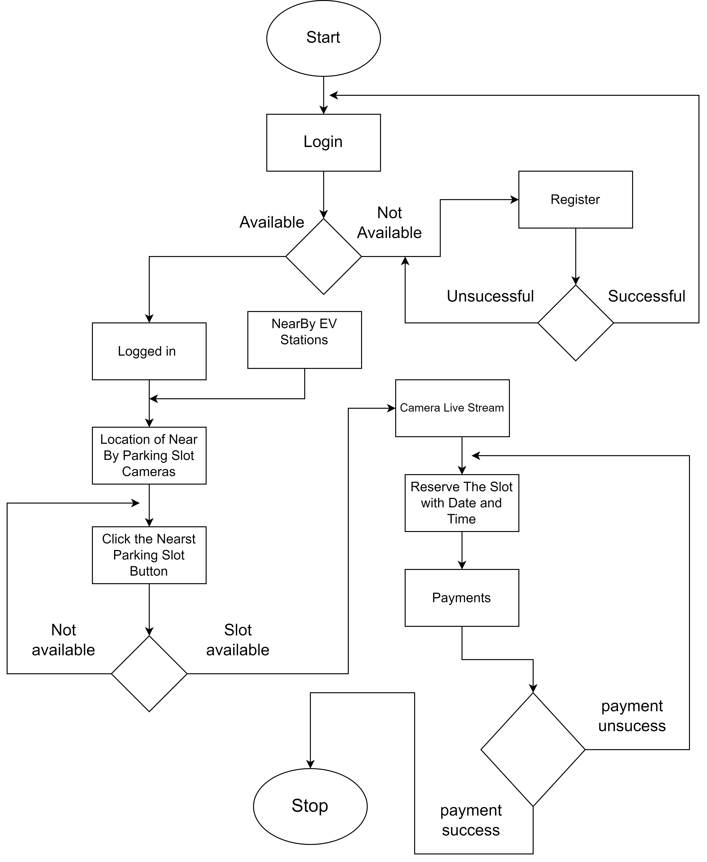
ACTIVITY DIAGRAM

Slide 8
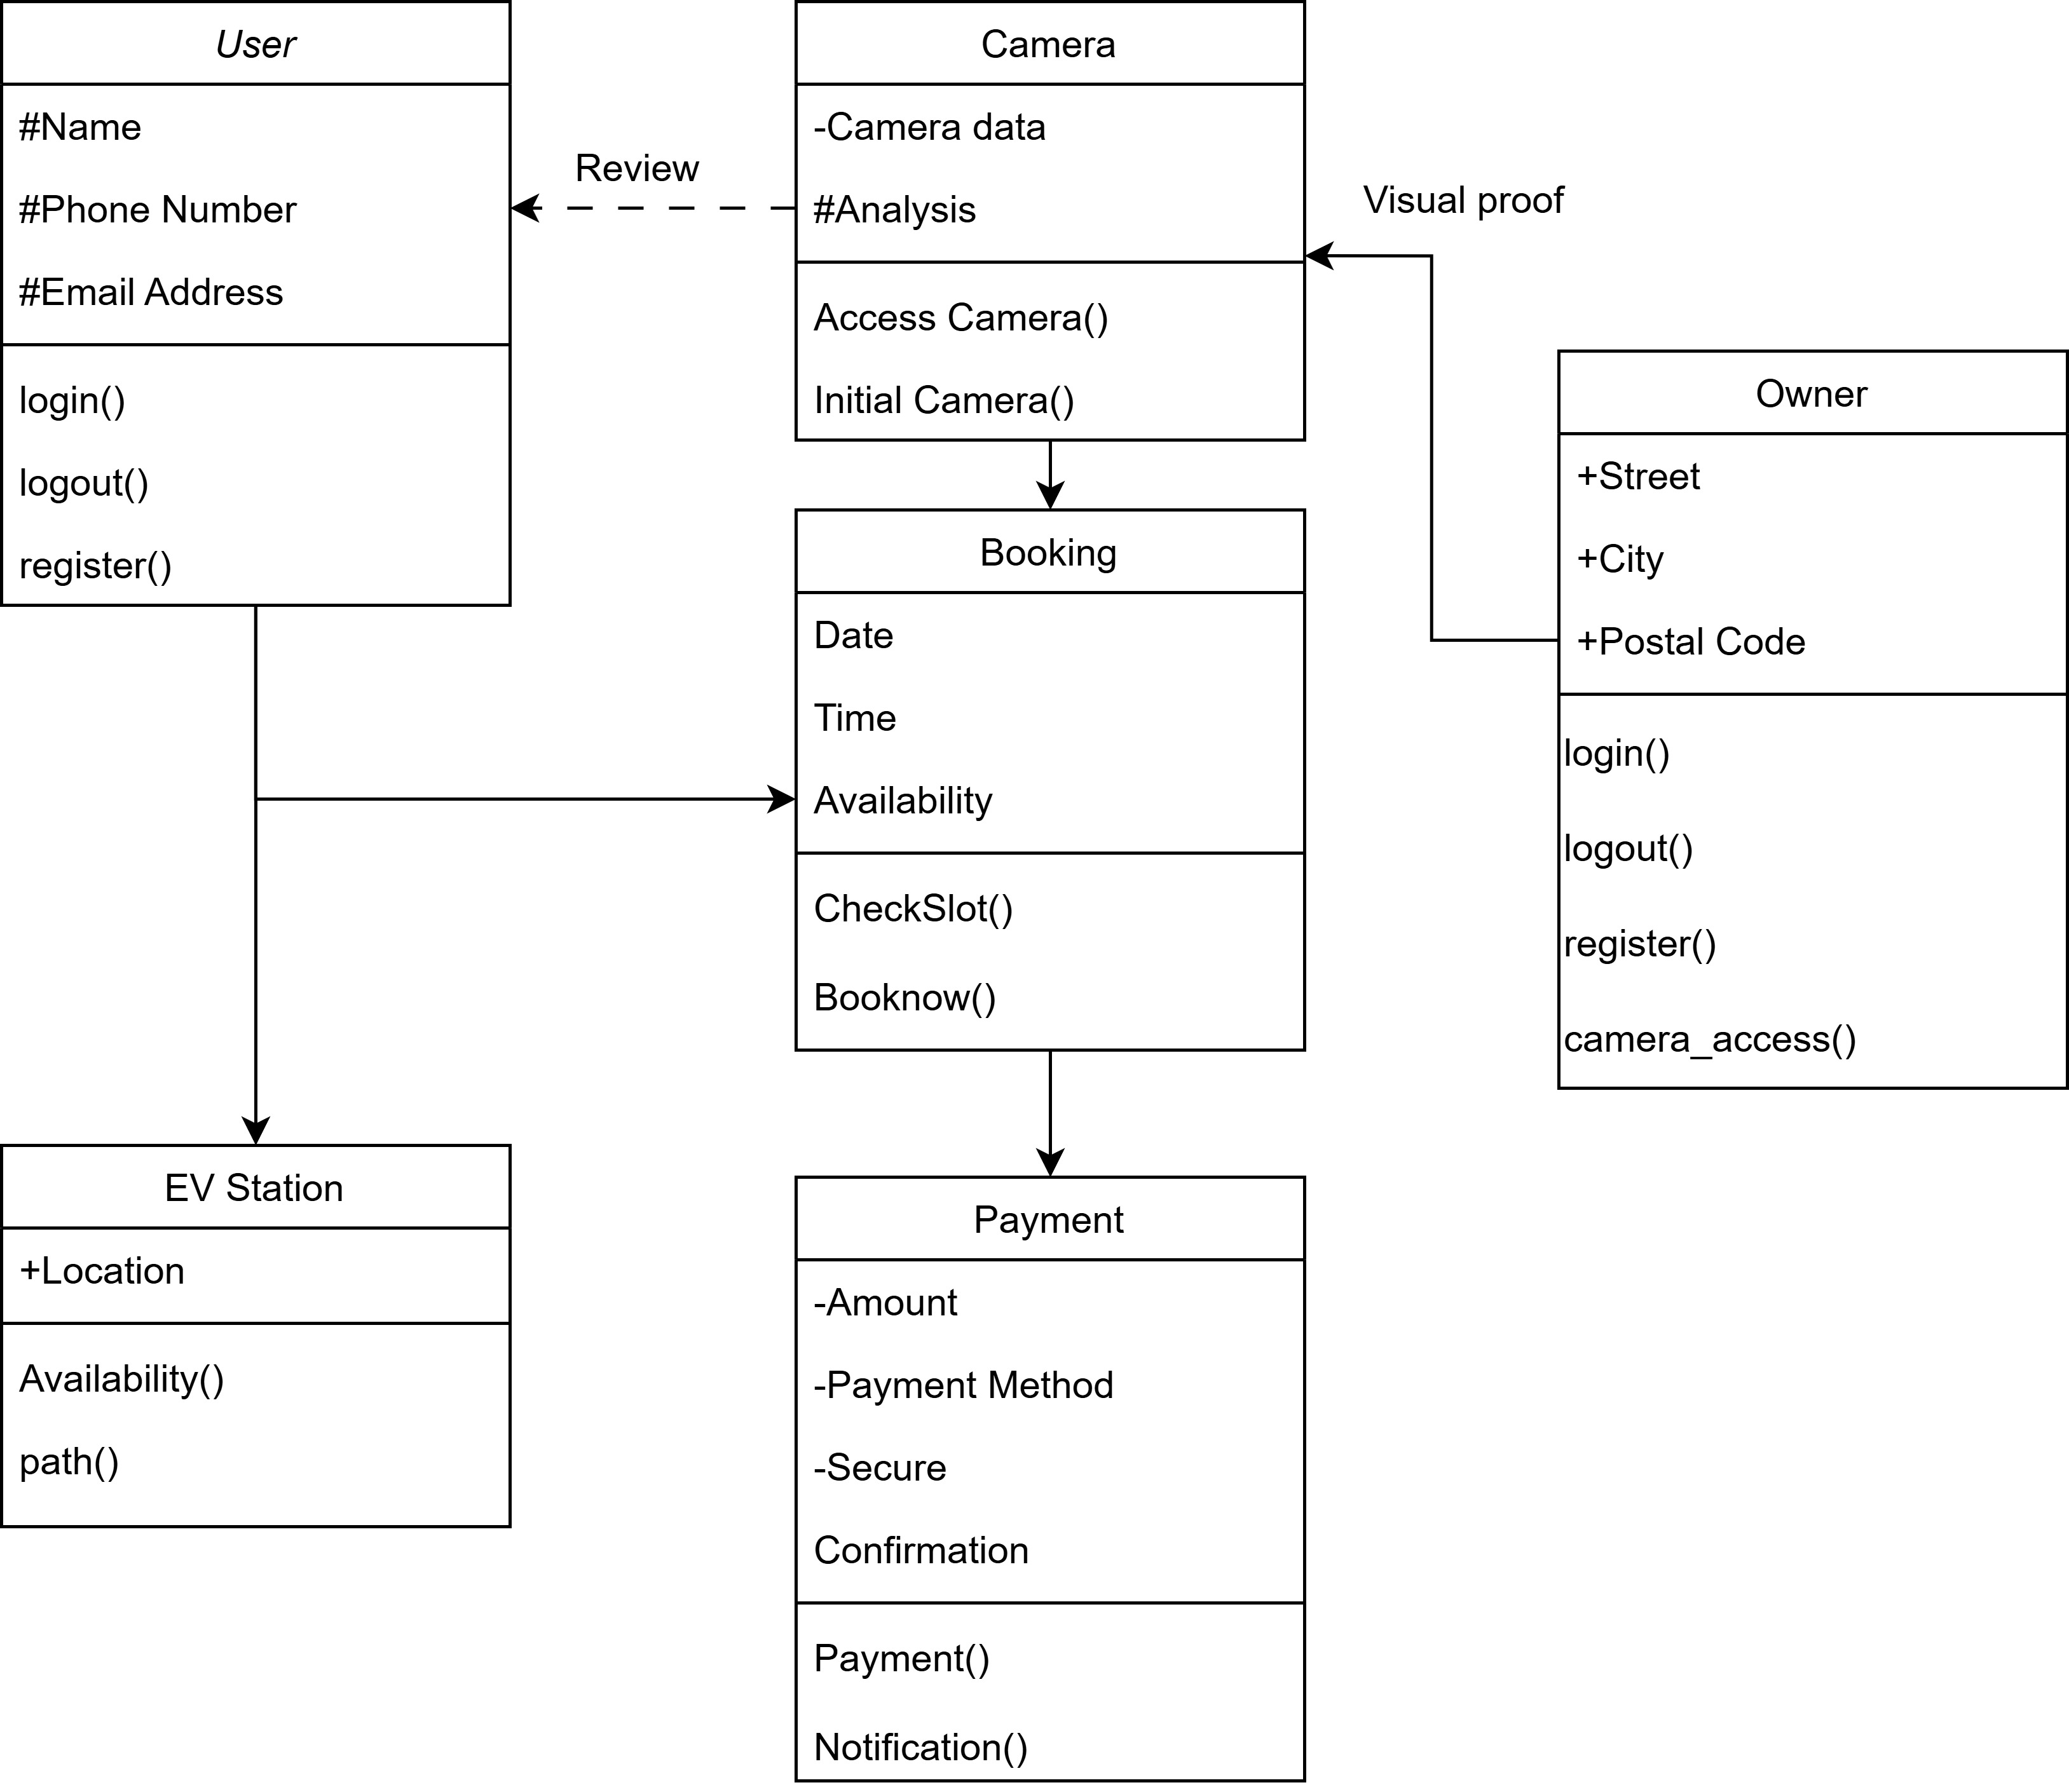
CLASS DIAGRAM

Slide 9
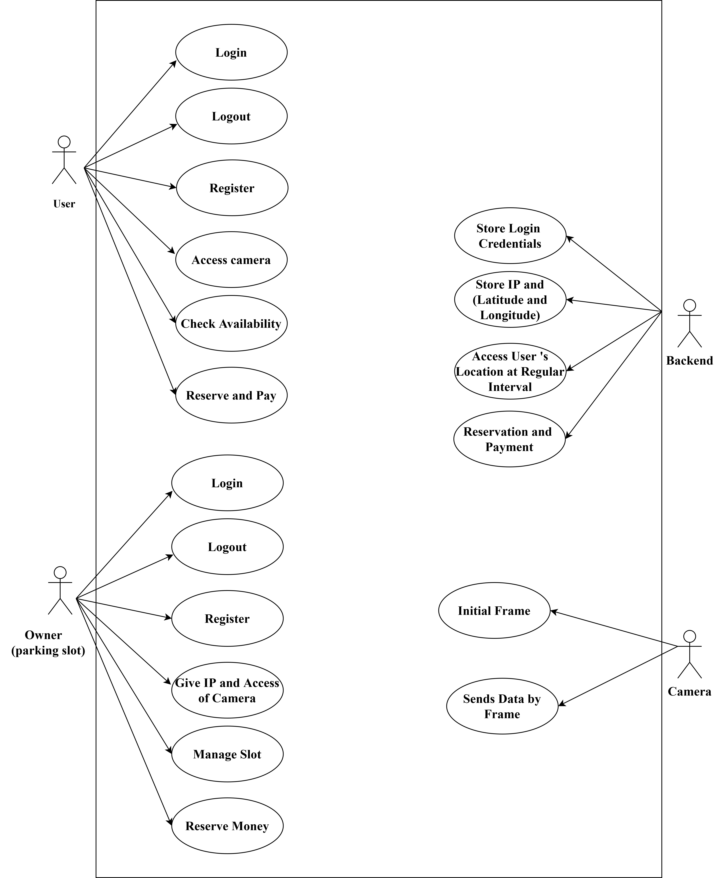
USECASE DIAGRAM

Slide 10
USER STORIES
AS A USER:
I want to search for available parking spots in real-time.
I want to reserve a parking spot and pay for it before arriving at my destination.
I want to get the location of nearby EV stations
AS A PARKING LOT OWNER:
I want to monitor space availability and manage reservations.
AS AN EV DRIVER:
I want to find and reserve EV charging stations near my destination.

Slide 11
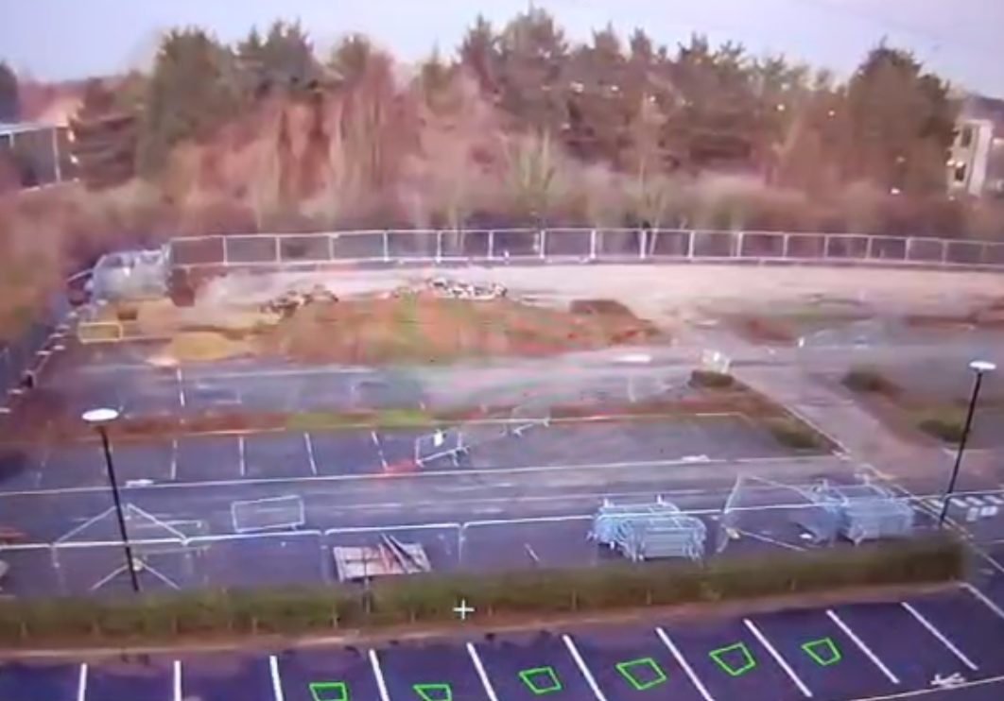
MODULE DESCRIPTION
Parking lot detection
Uses Python and OpenCV to detect and update parking space availability in real-time.

Slide 12
CONCLUSION
This mobile application solves the parking and EV charging challenges faced by urban drivers. Through real-time detection of parking spaces using Python and OpenCV, integrated with a booking and reservation system, the app simplifies parking management. Additionally, the inclusion of EV station finders ensures electric vehicle drivers can easily locate and charge their cars. By bridging the gap between parking lot owners and drivers, this app optimizes parking space usage, increases efficiency, and improves the overall user experience.

Slide 13
REFERENCE
Real-Time Parking Monitoring Using Image Processing Techniques" Authors: K. Mandal, P. Sinha, and A. Bose Summary: This research presents a real-time parking monitoring system using image processing techniques such as contour detection and object tracking to identify vacant and occupied spots.
Electric Vehicle Charging Station Availability and Reservation Management in Smart Cities Authors: L. Shao, X. Ma, and Q. Song Summary: This paper focuses on managing the availability and reservation of EV charging stations in smart cities, integrating real-time data to help EV users efficiently find charging spots.

